Slide 1

Orbital 2019
Introduction to Android App
Development

Slide 2

What is this section gonna cover:
A short intro to Android
Reasons to develop in Android
Features of Android Development
(language, mobile app communications, etc.
Work model & Timeline Breakdown
Useful Resources

Slide 3

What is Android?
A software Platform and OS for Mobile devices developed by Google

Slide 4

Developed as Linux Based Mobile Device OS
100% Pure Java Code
An Open Platform for Developers, Users & Industries

Slide 5
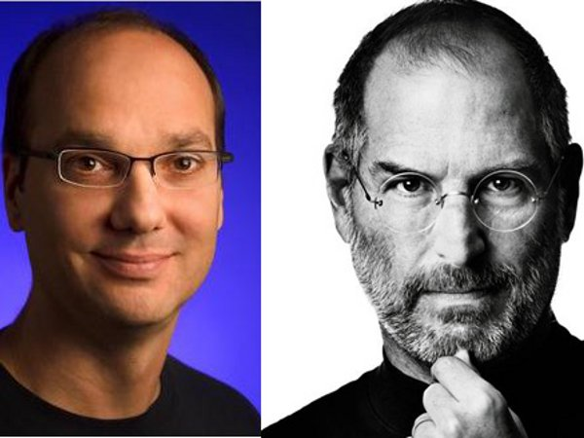


Slide 6
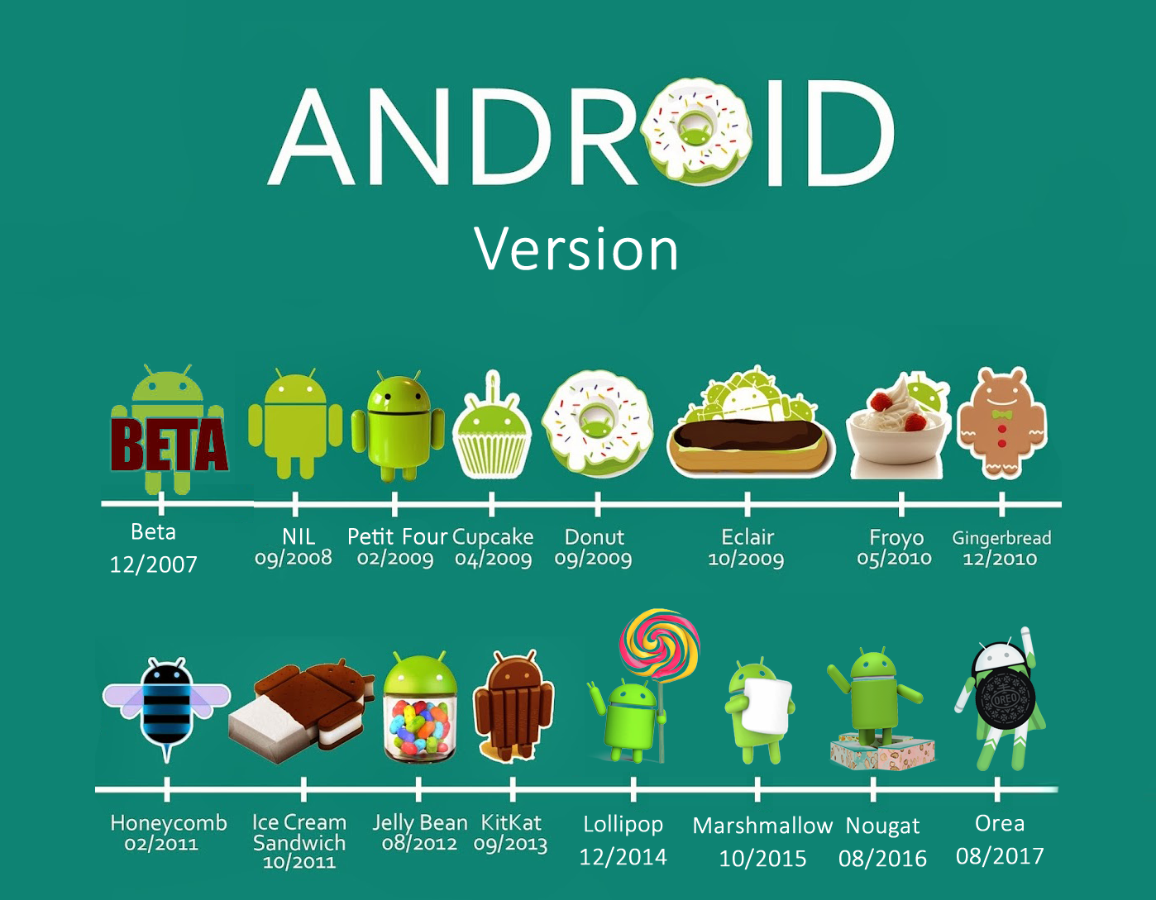

Slide 7

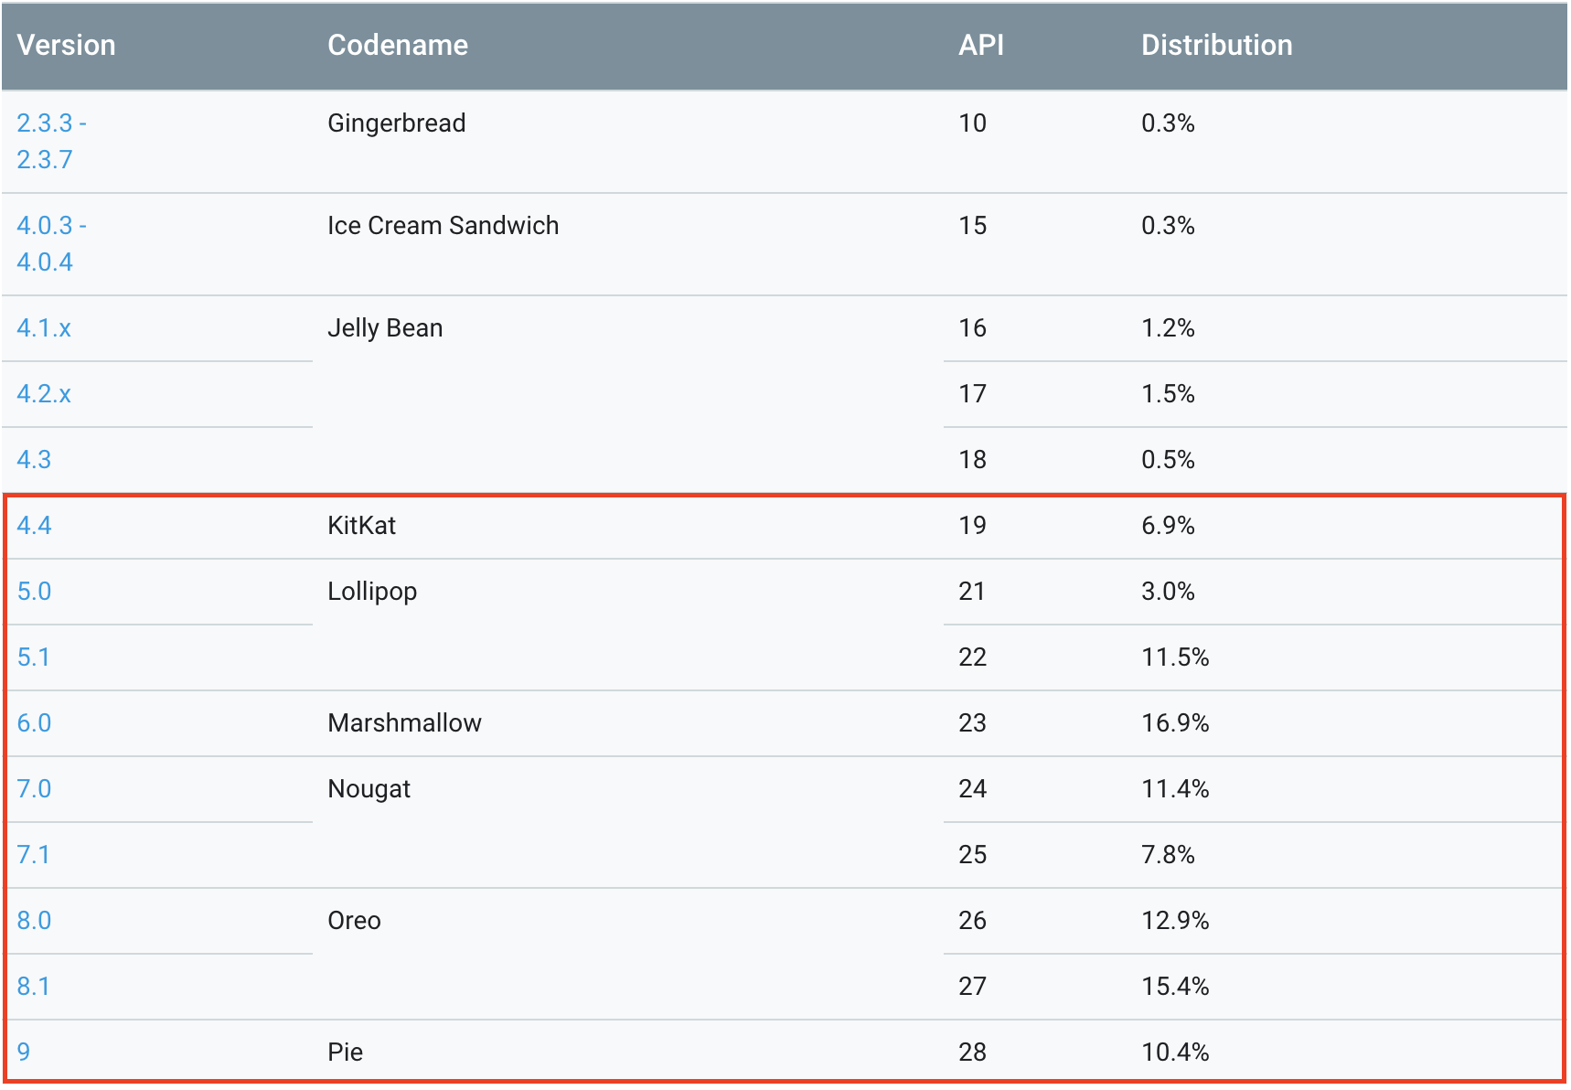
We will be using…Android KITKAT & ABOVE!
More information: https://developer.android.com/about/dashboards/

Slide 8

Why Android?

Slide 9
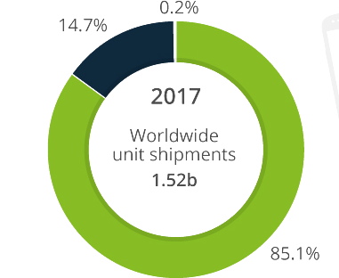
Worldwide smartphone shipments & OS “market share”
To date, Android has about…
86.1% Market share
2.8 Million Apps
Two Billion monthly Active Users
Six Million Android Developers

Slide 10
Mobile Platforms
Type | Language | Development | Publish | Cost to Publish | Benefits
IOS | Swift, Obj-C | Xcode (MACOS) | App store | $99 Per-year | Fluid UI. Better security
Android | Java, Kotlin, | Android Studio | Google Play Store | $25 one-time | Open-source, customizable. Easy to adopt
Window 10 Mobile | HTML5, Javascript, | Visual Studio | Microsoft Store | Free | Compatible with desktop counterparts
BlackBerry 10 | .NET C#, | Theme Studio | Amazon Appstore | Free | Friendly community?

Slide 11


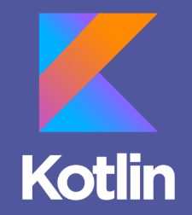

Language supported by Android Studio 3.X.X

Slide 12


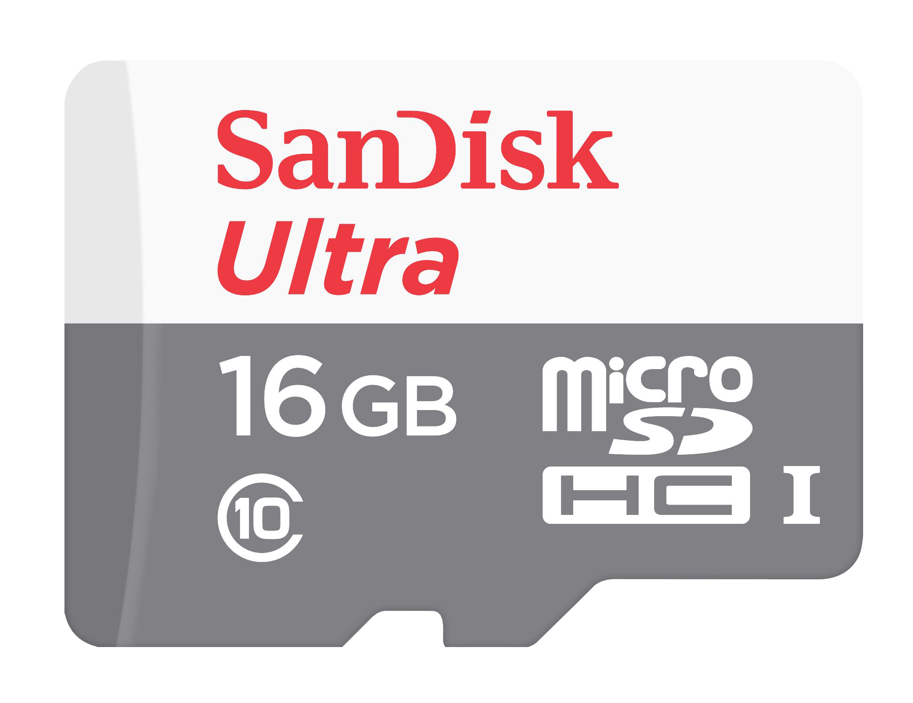
Typical Mobile apps communication
API
Local Storage

Slide 13
WAKAO SO difficult! Where do I start?

Slide 14
Process of creating your application
IDEATION
PROTOTYPING
IMPLEMENTATION

Slide 15
IDEATion - Key Features
Bluetooth?
Location?
Messaging?
Problem
Statement
Navigation?
Notification
Map?

Slide 16
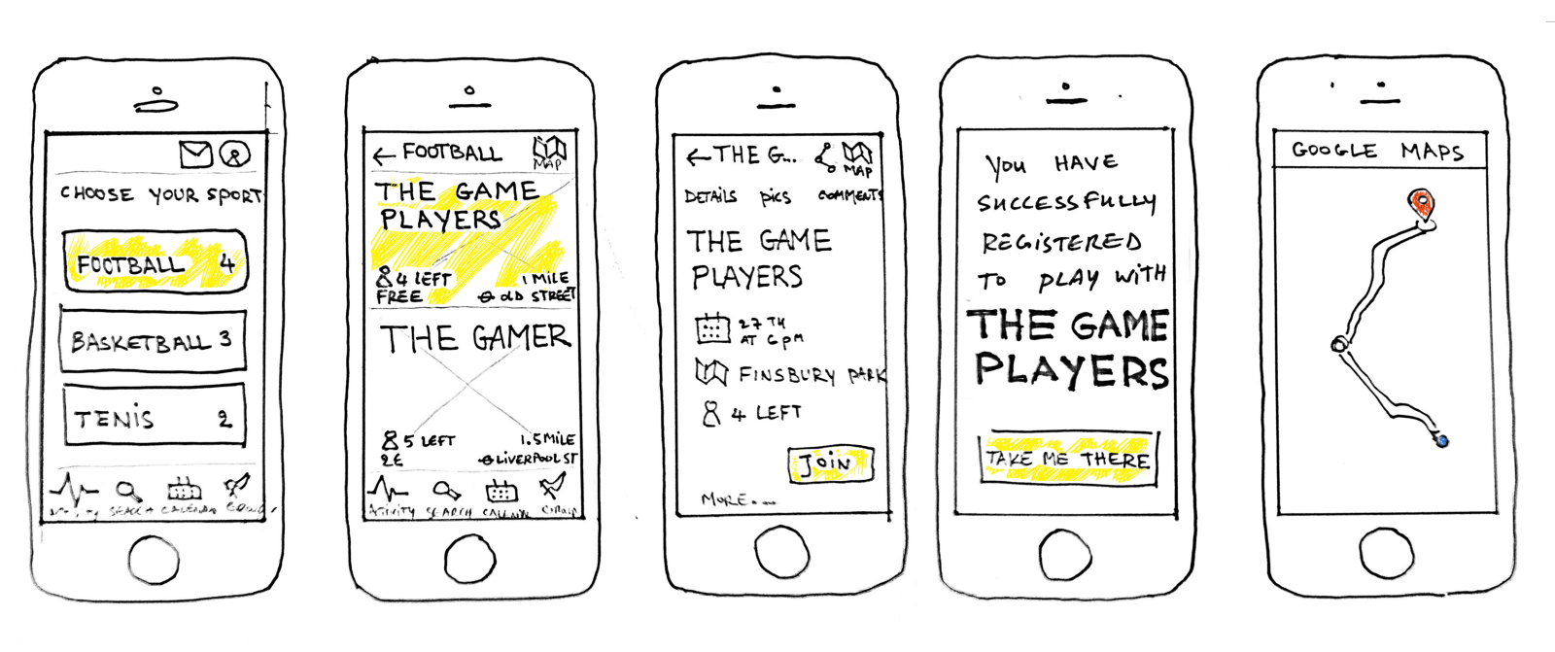
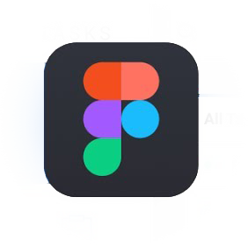




Prototyping – Sketches and Wireframe
Tools (Examples)
Online:
FIGMA
Webflow
Download required:
Balsamiq
Axure RP
Sketch on Invision (MAC)
Link to paper sketches:
https://webdesignledger.com/10-free-printable-web-design-wireframing-templates/#07b6590631
Notes:
Prototyping is also a vital step towards the success of your project. I know you guys are very eager to code but you guys also need to keep in mind of your users in term of UI and UX. You don’t to run into a situation whereby u realize you are missing a feature and add it last minute only to clutter your screen. You want to create an app where logic flow smoothly and procedures make as much sense to the users as possible.
Here are some prototype tools that I would recommend to get you started:
The first two runs on web and does not require any downloading. They are pretty idiot-proof and user friendly in my opinion.
However if u want something that could run offline, you might want to download software such as Balsamiq, Axure or Sketch on Invision. (Sketch and Invision are two separate components – SKETCH is a prototyping tool that runs on mac while Invision is an online tool that allows you map hotspot between pre-made screens). If I am not wrong Balsamiq and Sketch offers users a 30-days trial, thus u guys can use it during the prototyping stage. For those we prefer to build their own UI asset from scratch can always stick to Photoshop which offers more advanced tools such as stamp and brush tool to customize your layout
If you are super duper lazy, no worries, you guys can draw your prototype on paper, cut them out and pass it on a wall (a common practice by big companies such as Facebook and Google) I have provided the link to some mobile wireframe template which you can print out and draw on them. Be sure to check them out. Again, I want to emphasis the importance of this stage, as companies invested a lot of time and effort in getting their UX right for customers.

Slide 17
Implementation (Backend)
Backend 3rd Party
Firebase
Backand
Parse
PubNub
3rd party
Openweather API/Yelp APi
Or host your own backend via…
Google app engine
Herokuapp
AWS

Slide 18

Combine-into-one
IDEATION
PROTOTYPING
IMPLEMENTATION

Slide 19
Examples

Slide 20
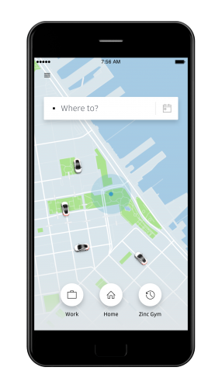
Example 1 - UBER
Features
Native App recommended
Location/Map Services
Google places API
Autocomplete
Google maps API
Actual map
Waypoints
Estimated Time

Slide 21
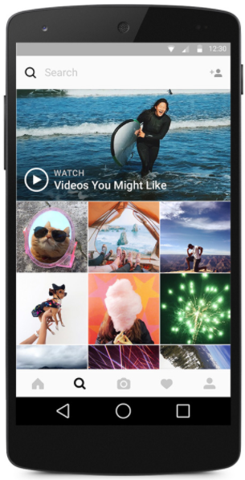
Example 2 - Instagram
Features
Native App recommended
Camera/Photos
Messaging
Firebase cloud messaging
Interface
Grid layout
Notes:
Grid layout: to provide as much content as possible with minimal user actions to improve user productivity - it’s all about UX

Slide 22
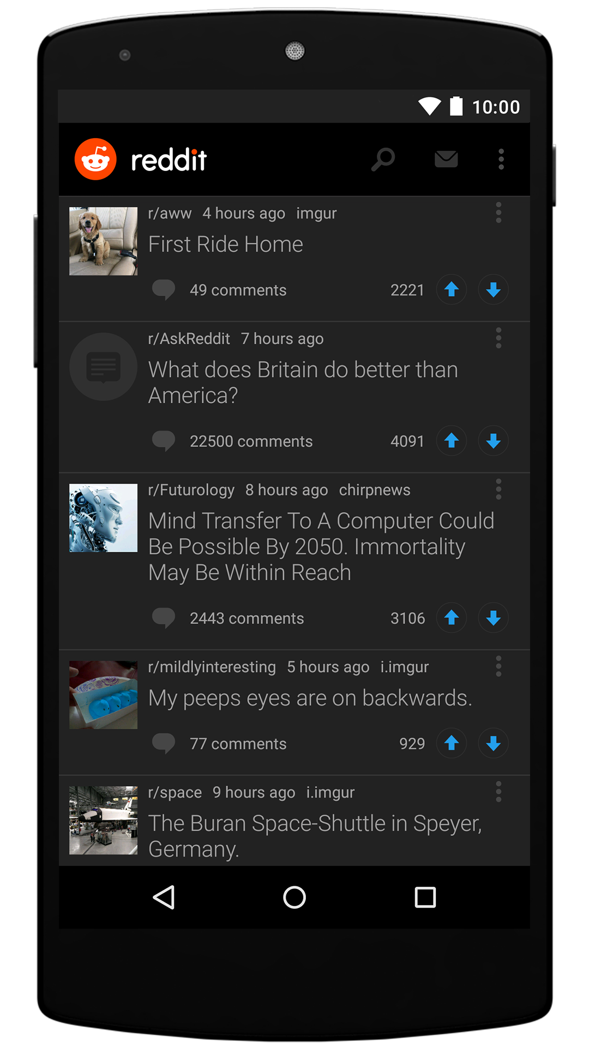
Example 3 - Reddit
Features
Content Driven
Customizable content
Offline Access
Store top 50 content
Vertical Scrolling

Slide 23
Features of Android app (In Summary)
Native Features
Sensors (Pedometers, Accelerometer, compass)
Bluetooth (Wearables)
Camera
Fingerprint Capability
Push notification
Multi-touch fns
AR/VR
GPS
Key Features
Media support for common audio, video & img format
Offline access
Build in SQLite
Developer Logger fns
Optimized graphics - VGA ,2D/3D

Slide 24

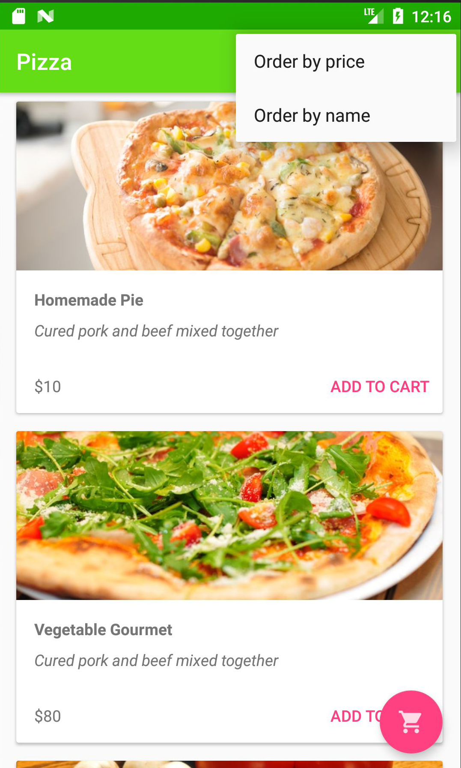
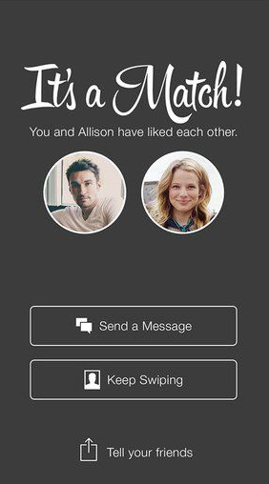
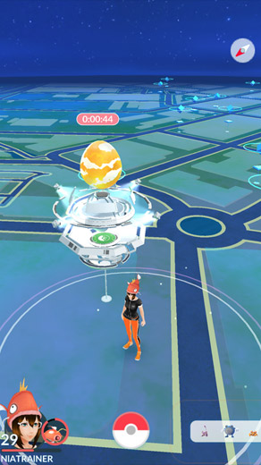
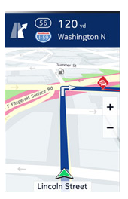
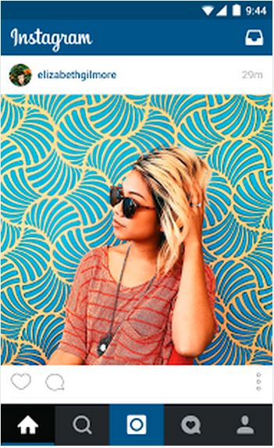
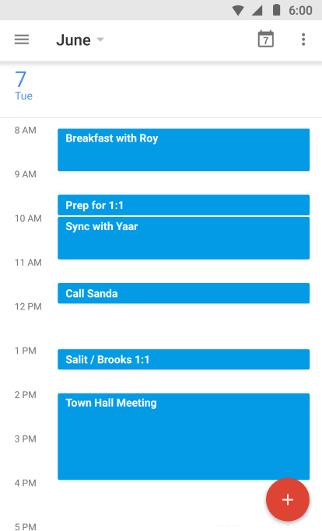

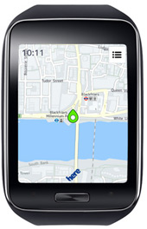
Notes:
I have yet to explore all of the feature mentioned but I am looking forward to see them incorporated in your Orbital project. With these features you can create amazing app like angry bird, tinder, delivery app, etc. Hence, you guys can start thinking of what you guys plan on creating when you embark on your own project.

Slide 25

Timeline

Slide 26
Suggested Timeline Breakdown
Ideation (3 weeks)
Research on product
Outline product features
Prototyping (2 weeks)
Mock-ups / Sketches
Wireframing and Storyboarding
Implementation (7 weeks)
Architecture Design
Product Development
Remaining weeks
Perform validation, review and reiterate
User Guide
Server Hosting (if applicable)

Slide 27
Orbital Timeline 2018 (for reference)
Milestone 1 (4th June )
Ideation: Research and project outline (3 weeks)
Prototyping: Mockup / Sketches (1 week)
Milestone 2 (2nd July)
Prototyping: Wireframe & storyboard (1 week)
Implementation: Architecture Design (1 week)
Implementation: Backend + Frontend (2 weeks)
Milestone 3 (30th July)
cont. Implementation (4 weeks)
Testing // to do done in-between
To Splashdown (5th September).
School open on 13th Aug
Poster design
Minor Refinements (Adjustments, reiterations, documentation)

Slide 28
Helpful Sources
Online courses
Udemy/Coursera/Tutorial point
Feature-based
Stack overflow
Developer.android (official android developer site, also include material design guideline*)

Slide 29
Thank You

